Slide 1
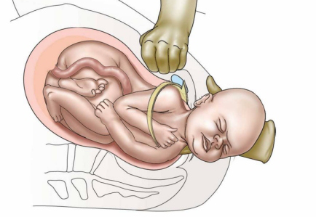
Shoulder Dystocia
Kipp Johnson

Slide 2
Biological and historical perspective

Slide 3
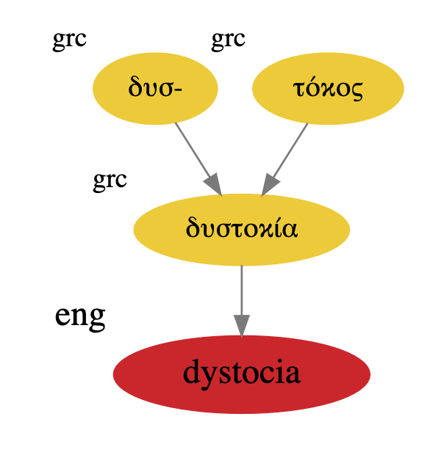
Etymology of Dystocia
Dus (dys) - Bad
tokos (tocia) - Childbirth

Slide 4

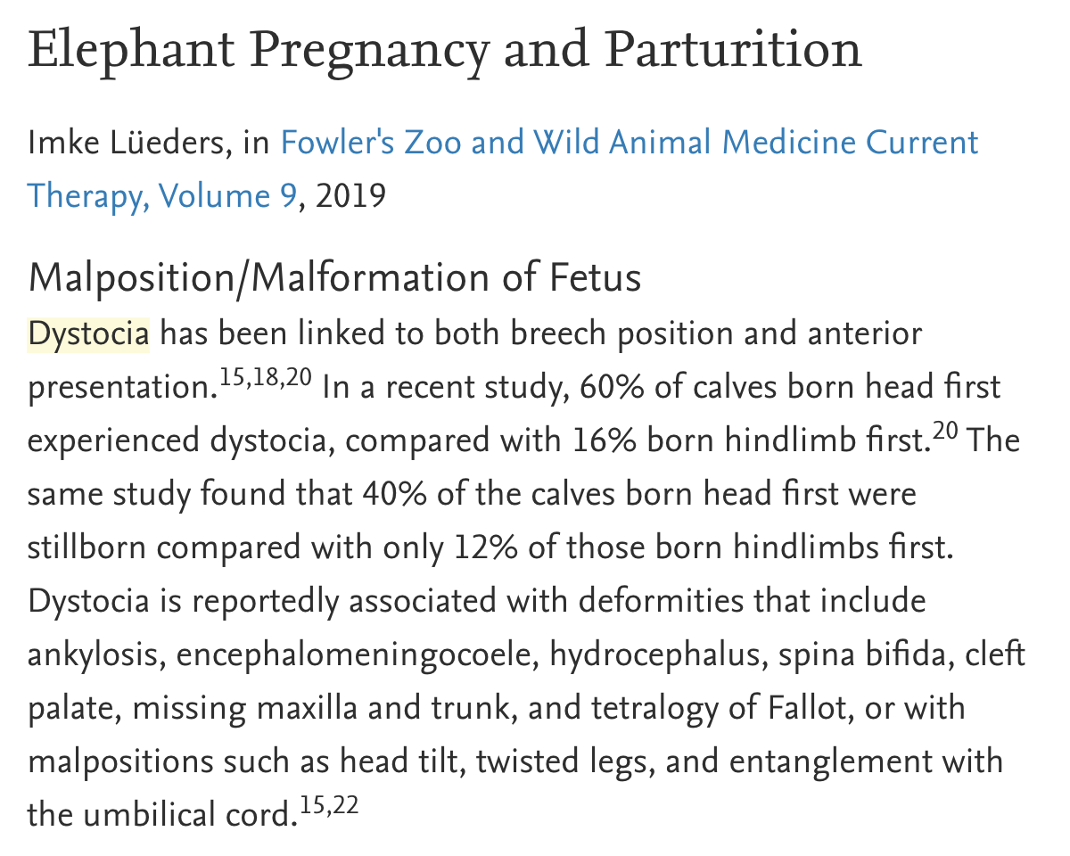
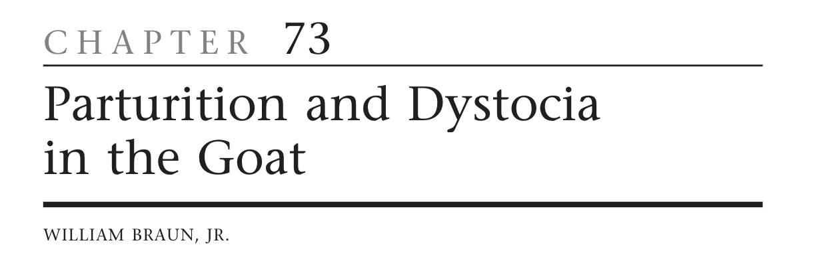


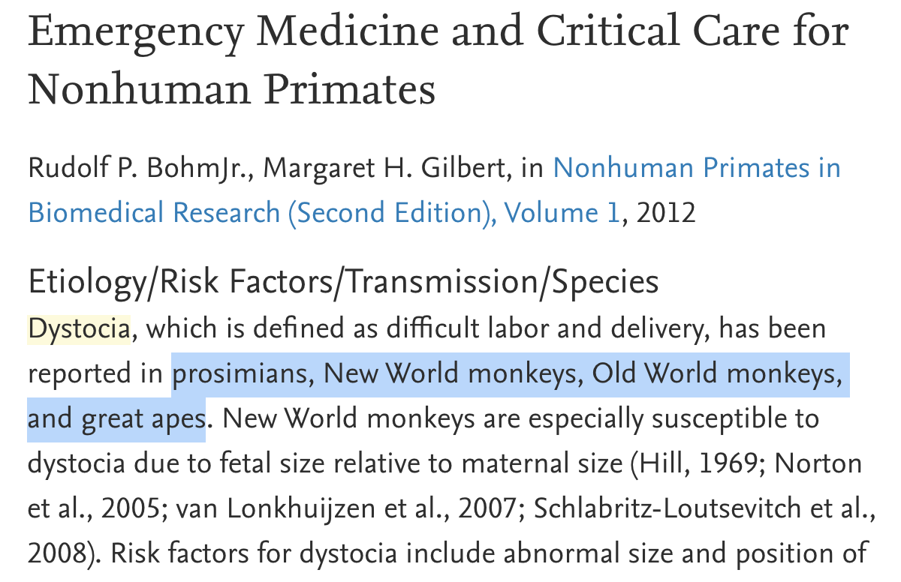
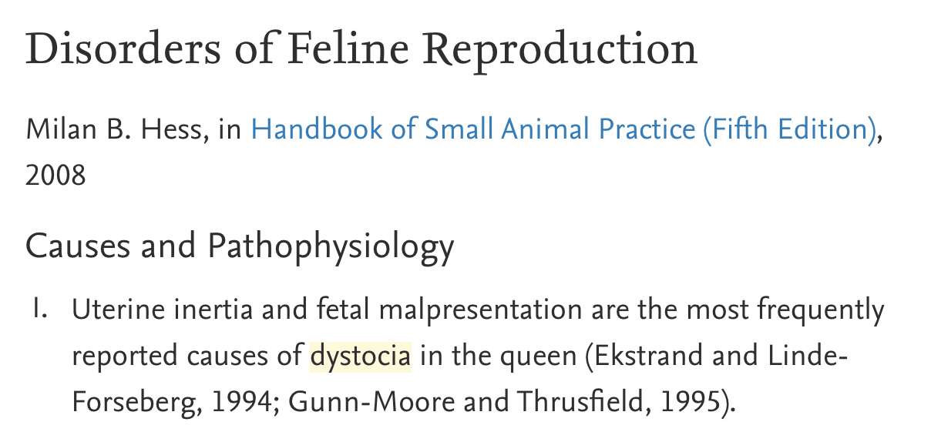


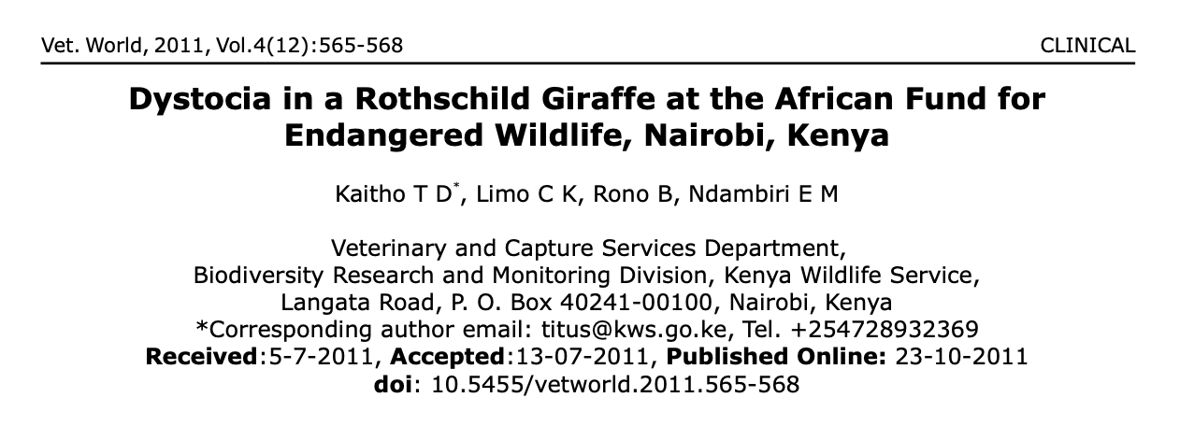
Not a uniquely human disorder

Slide 5
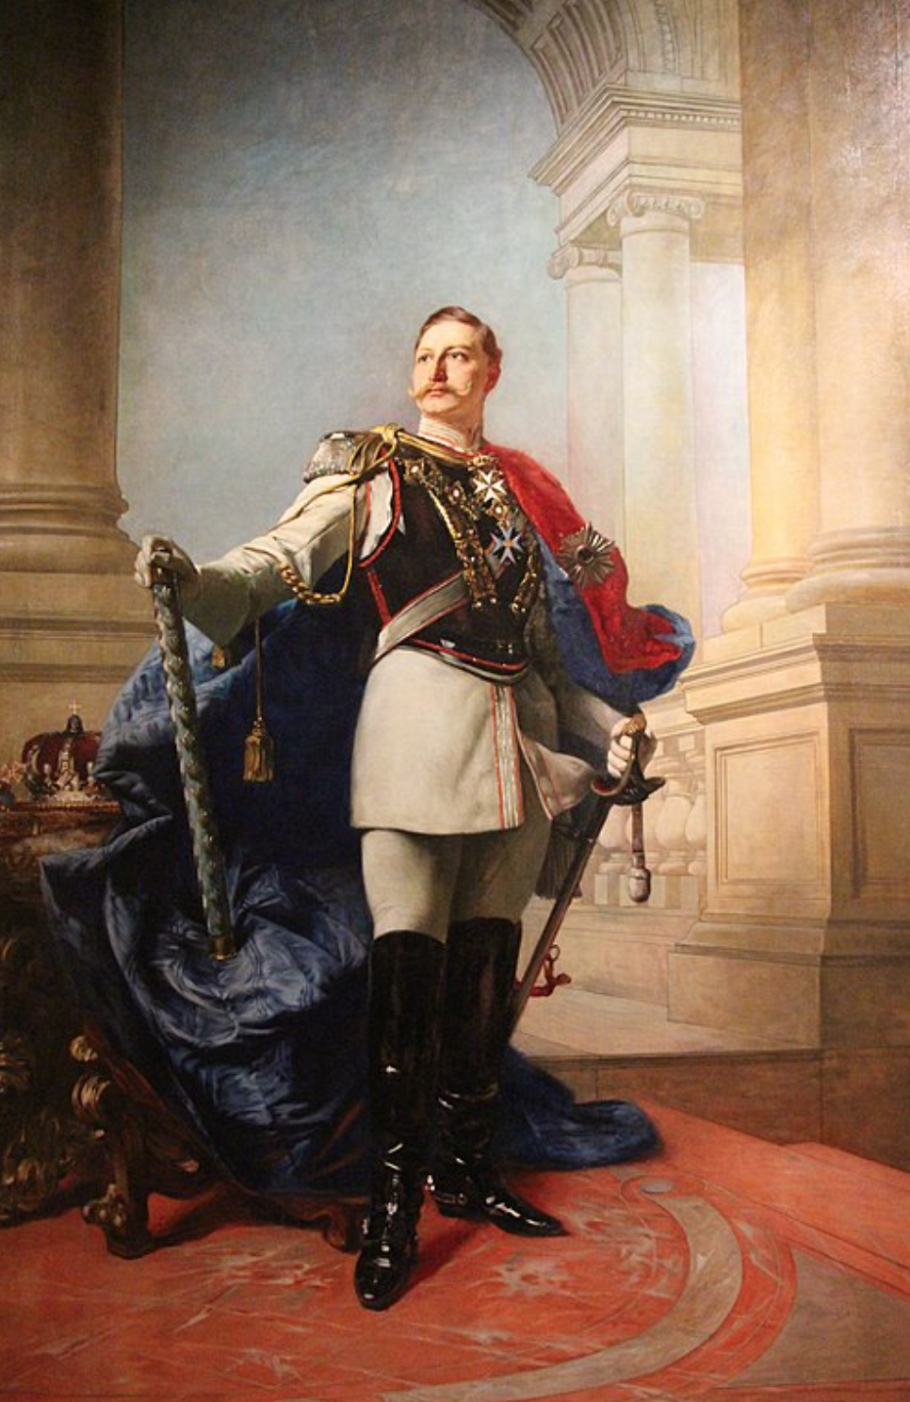

Slide 6
Kaiser Wilhelm II
Last Emperor of Germany
(painting)
Notes:
This is a PAINTING

Slide 7
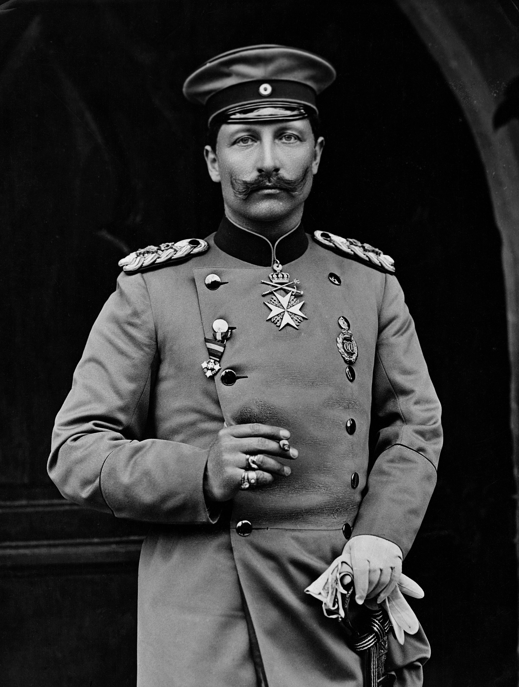
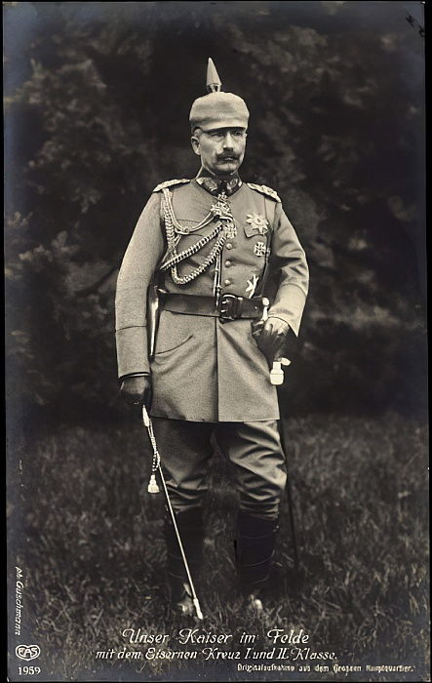
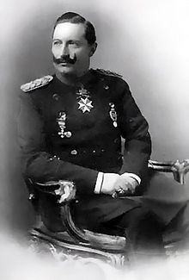
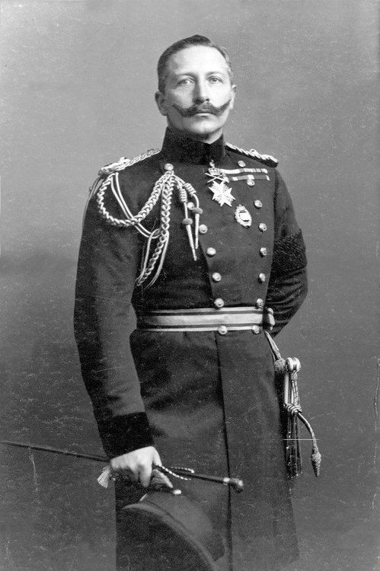

Slide 8
Kaiser Wilhelm II suffered severe shoulder dystocia during birth, which left his left arm withered and unusable
“An English doctor killed my father, and an English doctor crippled my arm, which was the fault of my mother”
… and his mother was English
Notes:
Queen Victoria mother, only allowed family to see English doctors

Slide 9

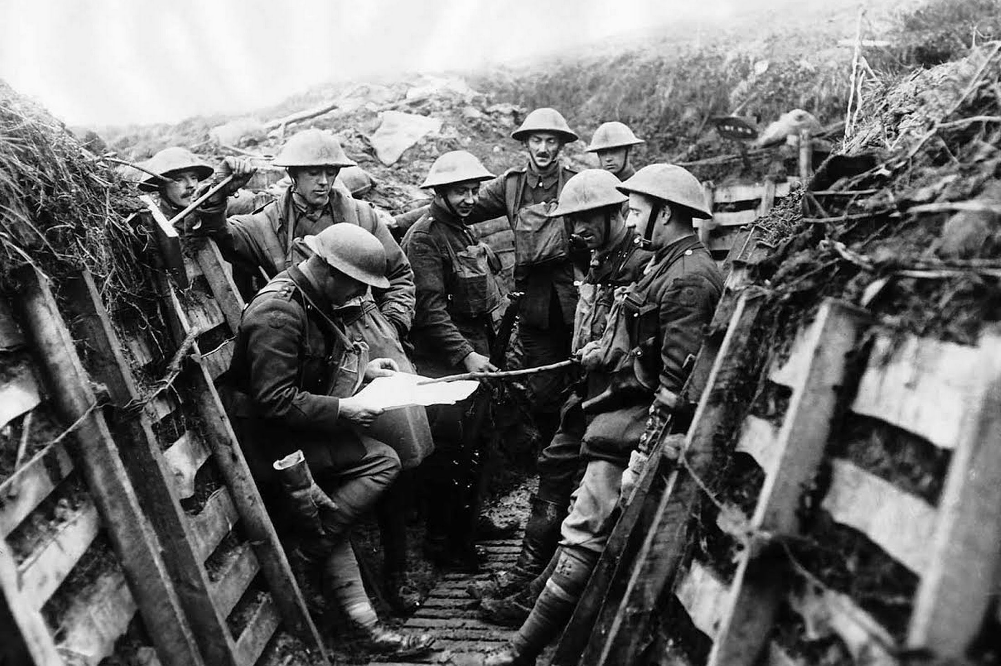
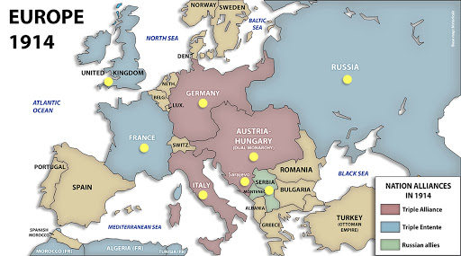
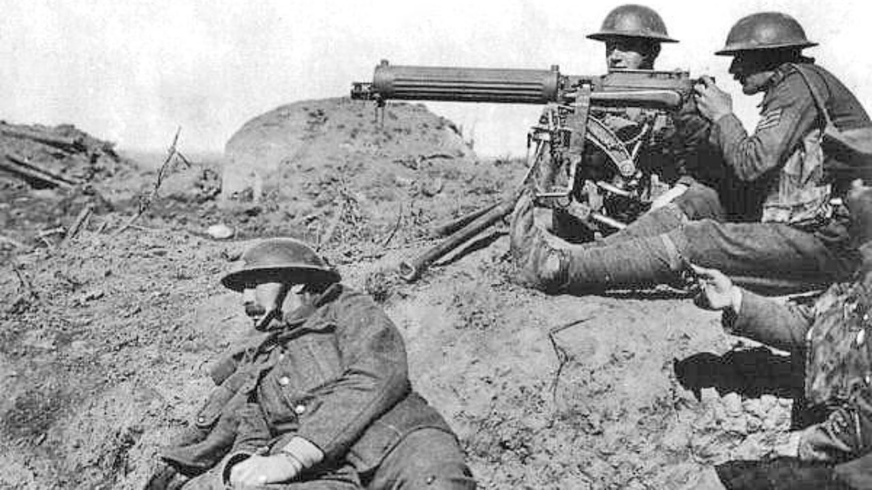
Notes:
Historians have speculated his insecurities around his withered arm 2/2 erb’s palsy from shoulder dystocia lead to his willingness to start WW1

Slide 10
Problems during labor can result in severe and long-lasting deficits
Notes:
Historians have speculated his insecurities around his withered arm 2/2 erb’s palsy from shoulder dystocia lead to his willingness to start WW1

Slide 11
Case Presentation

Slide 12
Case Presentation
CC: Labor, non-reassuring fetal heart tracing
HPI: NB is a 24 y.o. G1P0 @ 41w3d BIBEMS presenting in active labor, transferred from the Jazz Center [nearby birthing center] for a non-reassuring fetal heart tracing. Contractions are occurring every 2-3 minutes and are painful. Membranes ruptured for 4 hours.
Uncomplicated pregnancy to date with consistent care. No prenatal records are available.

Slide 13
History
Medications: Prenatal vitamins
Allergies: None
OB history: G1P000
GYN history: WNL
Past medical history: None
Past surgical history: None
Family History: NA

Slide 14
Physical Exam
Vitals: Temp 36.1°C, HR: 110, RR 18, BP 117/65 SpO2 99%
General: Young woman in moderate distress, odd affect
Cardiovascular: RRR, Normal S1/S2, Tachycardia
Pulmonary: CTAB
Abdominal: Soft, nontender, nondistended, no rebound, no guarding, fundus firm.
Pelvic: No bleeding. Cervix dilated to 9CM and 100% effaced.

Slide 15
Labs and Imaging
Labs:
Type & Screen: O+
CBC: WBC 21.4 (99% PMNs), HgB 12.6, HCT 39.4
Transabdominal ultrasound: Vertex presentation, anterior placenta, EFW 3000g
EKG: Sinus Tachycardia
Fetal Heart Rate Tracing: Recurrent variable decelerations, moderate variability (Class II)

Slide 16
Hospital Course
Pt initially declines epidural or other intervention (blood transfusions)
Recurrent decelerations to 90 BPM, temporarily resolves with fetal scalp massage. Scalp electrode placed.
Return to room in <1 hour, patient kneeling on bed beginning to deliver.
After re-positioning, patient laboring successfully until shoulder presentation with nuchal cord.

Slide 17

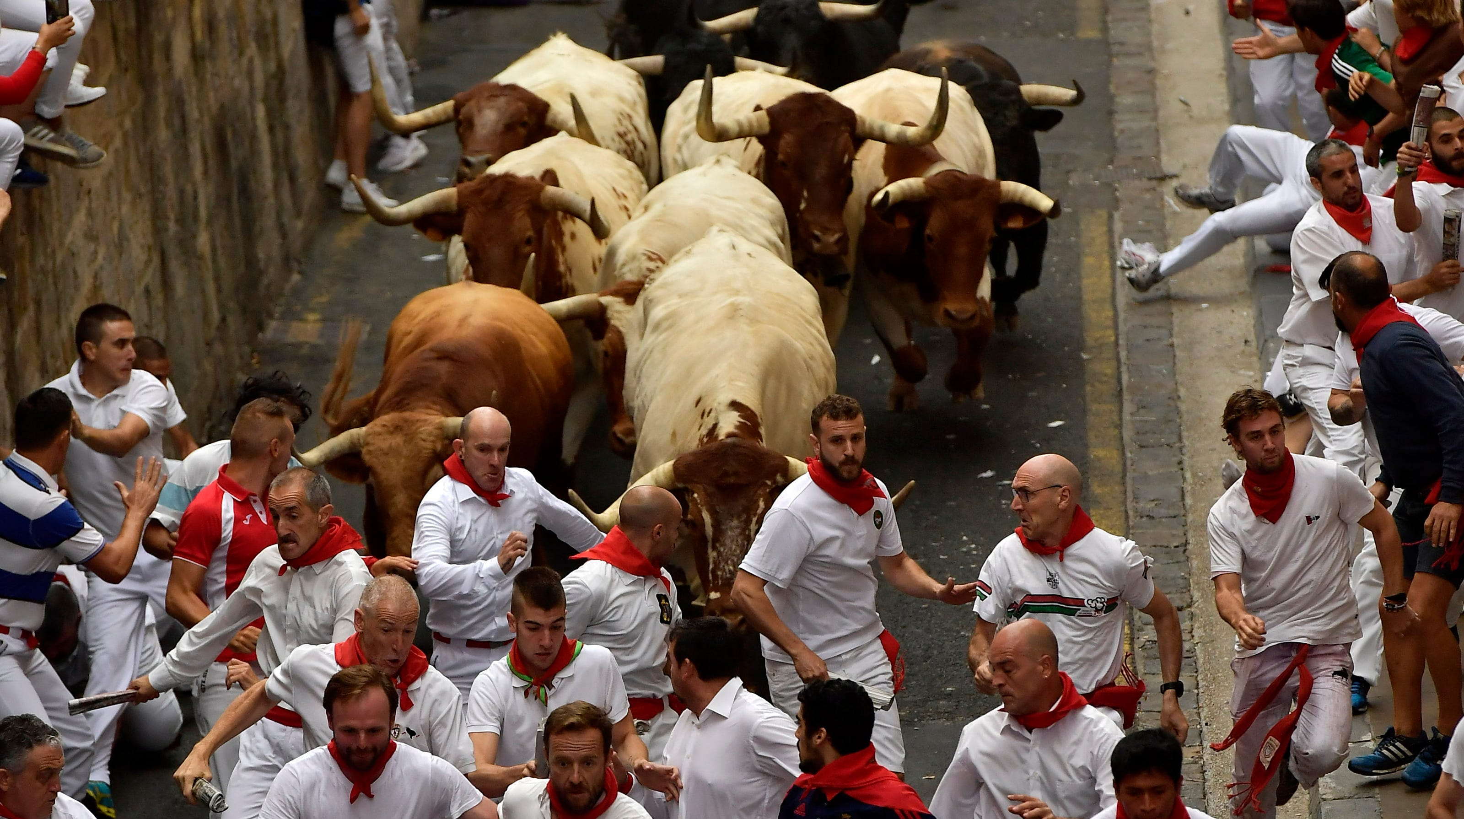
Shoulder!!!

Slide 18
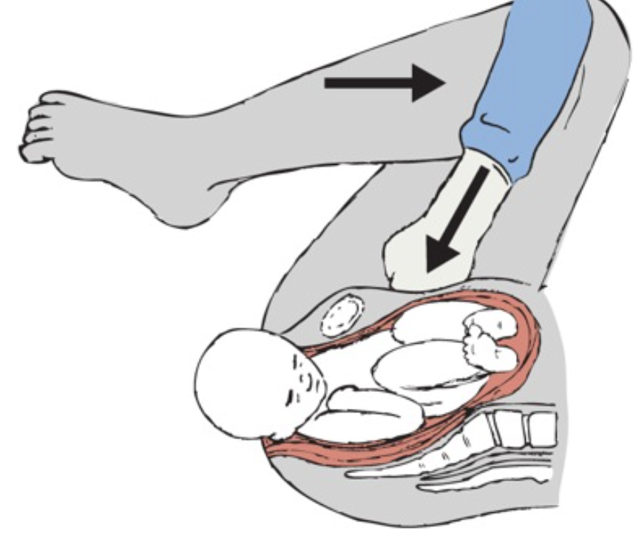
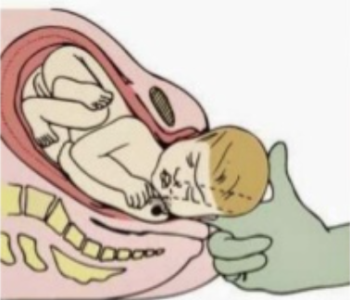
McRobert’s maneuver performed
Wood’s screw maneuver

Slide 19
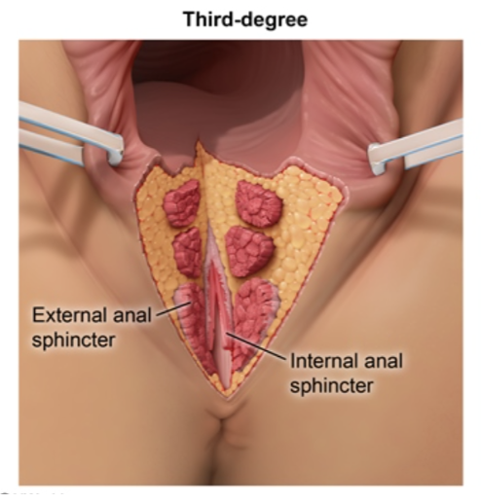
Case Conclusion
< 60s of shoulder dystocia
3650g (8 lb) infant, transferred to NICU
Poor respiratory effort, acidemia
Fully recovered and discharged after 1 day
3rd degree perineal laceration
Mother recovered well and left with infant on PPD #2

Slide 20
Differential diagnosis
Known shoulder dystocia
Concepts that go alongside shoulder dystocia:
Emergent delivery (generally)
Retraction of fetal head during delivery
Breech delivery
Umbilical cord prolapse

Slide 21
Epidemiology
Definition: Failure to deliver fetal shoulder or shoulders with gentle downward traction on the fetal head, requiring other obstetric maneuvers
Alternate definitions: delayed head-to-body delivery time (>60s, >5 minutes)
Incidence: 0.2% - 3.0% of NSVD depending upon definition used and study population
Likely ~2x more prevalent in operative vaginal delivery
Notes:
Some group have used definitions of head-toi-boidy delivery time (60 seconds or 2SDs above mean)

Slide 22
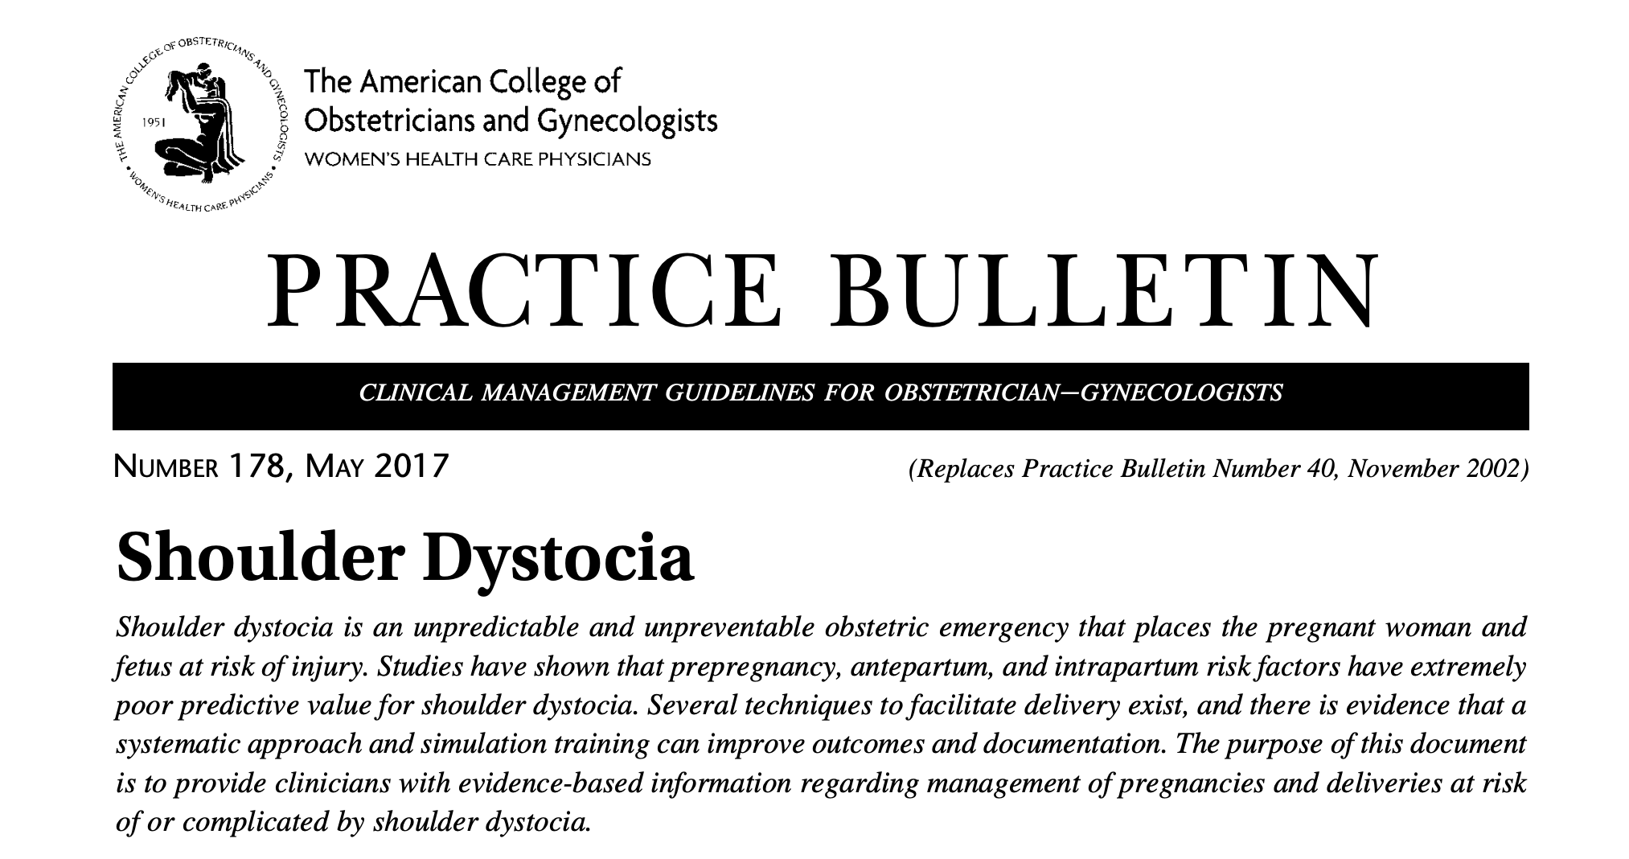
Risk Factors
ACOG Practice Bulletin 178: “An unpredictable and unpreventable obstetric emergency […] prepregnancy, antepartum, and intrapartum risk factors have extremely poor predictive value for shoulder dystocia”
About 50% of SD pregnancies have no identifiable risk factors

Slide 23
Risk Factors
high birth weight
maternal DM
previous shoulder dystocia (recurrence rate >10%)
post-term pregnancy
male fetal sex
maternal obesity
advanced maternal age
operative vaginal delivery
precipitous or prolonged labor

Slide 24
Pathophysiology
Descent of fetal head while anterior or posterior shoulder remain obstructed
Fetal bisacromial diameter typically enters pelvis obliquely with posterior shoulder ahead of anterior shoulder; if the shoulders remain A-P during descent
Anterior shoulder can become impacted on symphysis pubis
Posterior shoulder on sacral promontory
Mechanical compression leads to symptoms

Slide 25
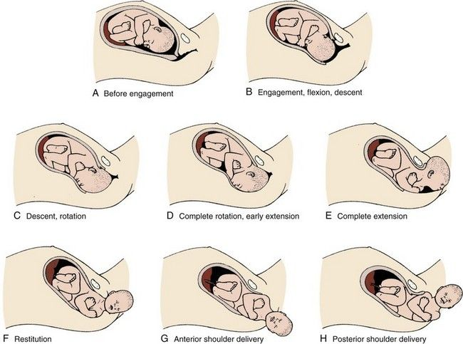
Pathophysiology
Cardinal movements of labor
Notes:
Anterior shoulder delivery more commonly problematic

Slide 26
Complications
Up to 95% of the time, no major complications
Brachial plexus injury (Especially Erb or Klumpke palsy)
Transient (3-17%)
Permanent (0.5-1.5%)
Clavicular fracture (1-9%)
Humeral fracture (0.1-4.2%)
Neonatal asphyxia and encephalopathy: (~0.3%)
Especially if infant is “stuck” for > 5 minutes
Death (<0.3%)
Maternal: 3rd and 4th degree lacerations, hemorrhage are common (up to 50%)
Notes:
Evidence for rates of complications vary widely

Slide 27
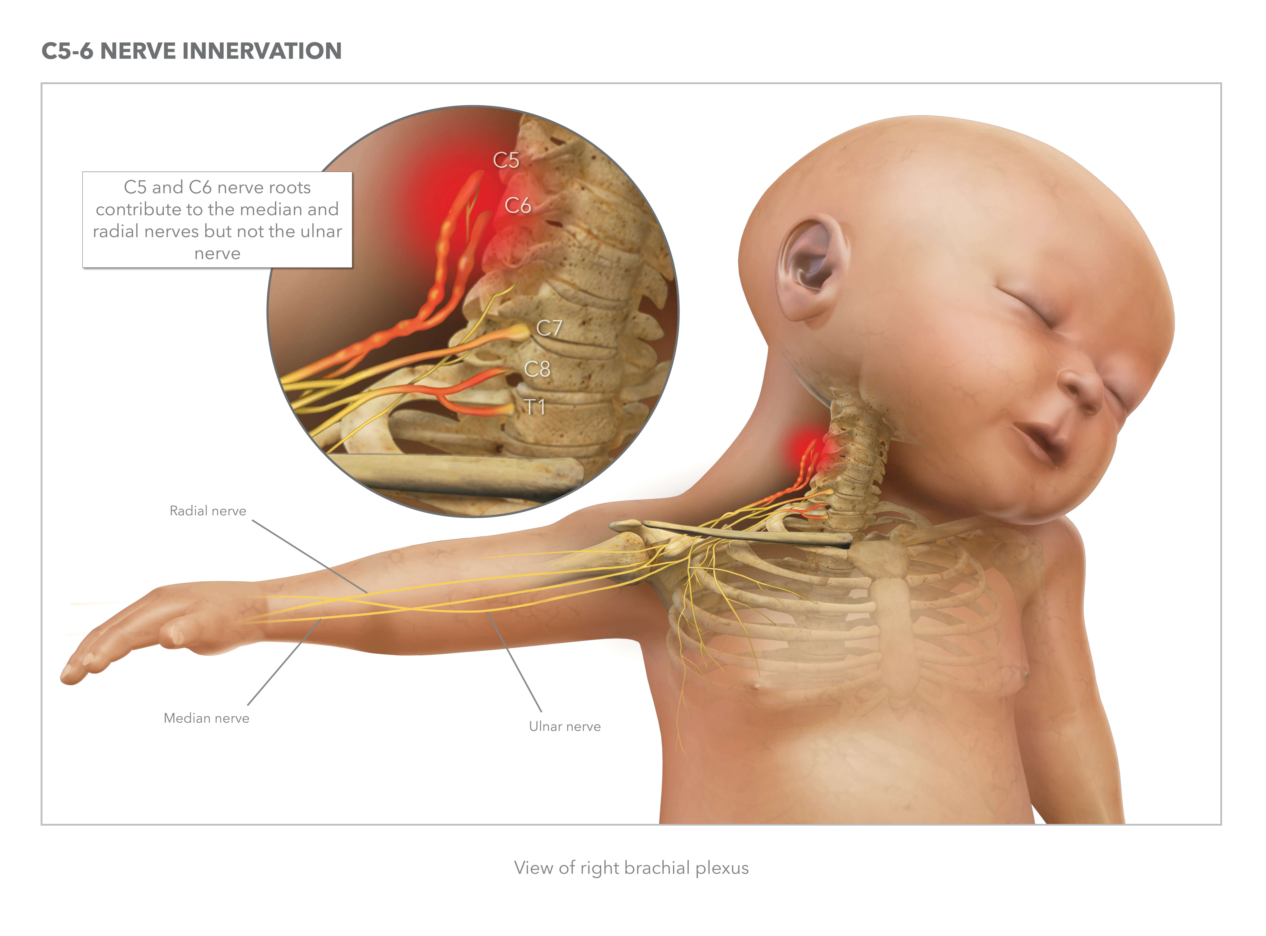
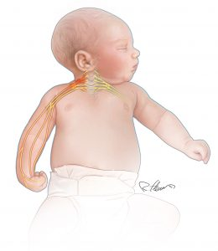
C5-T1

Slide 28
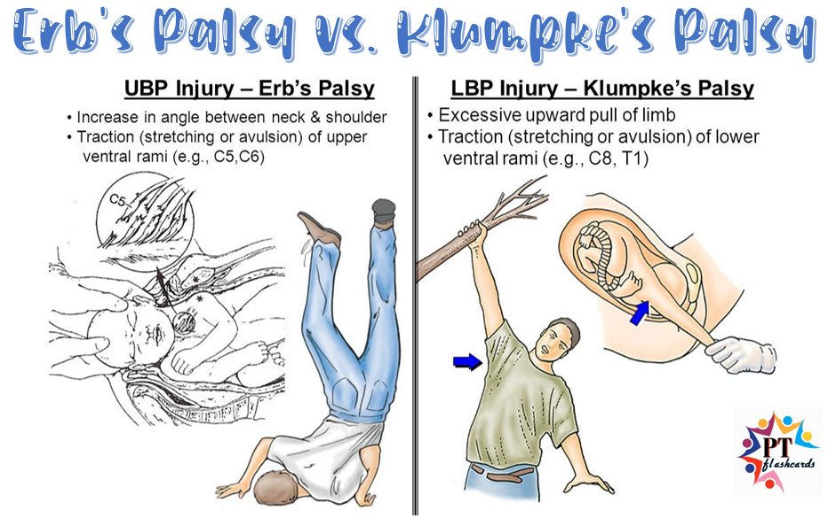

Slide 29
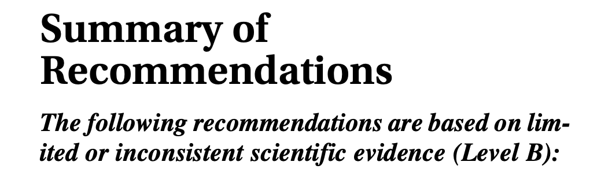
Prevention
Consider C-section for macrosmia
EFW >5kg
In women with diabetes, EFW > 4.5kg
Training:
Simulation exercises
Shoulder dystocia drills

Slide 30
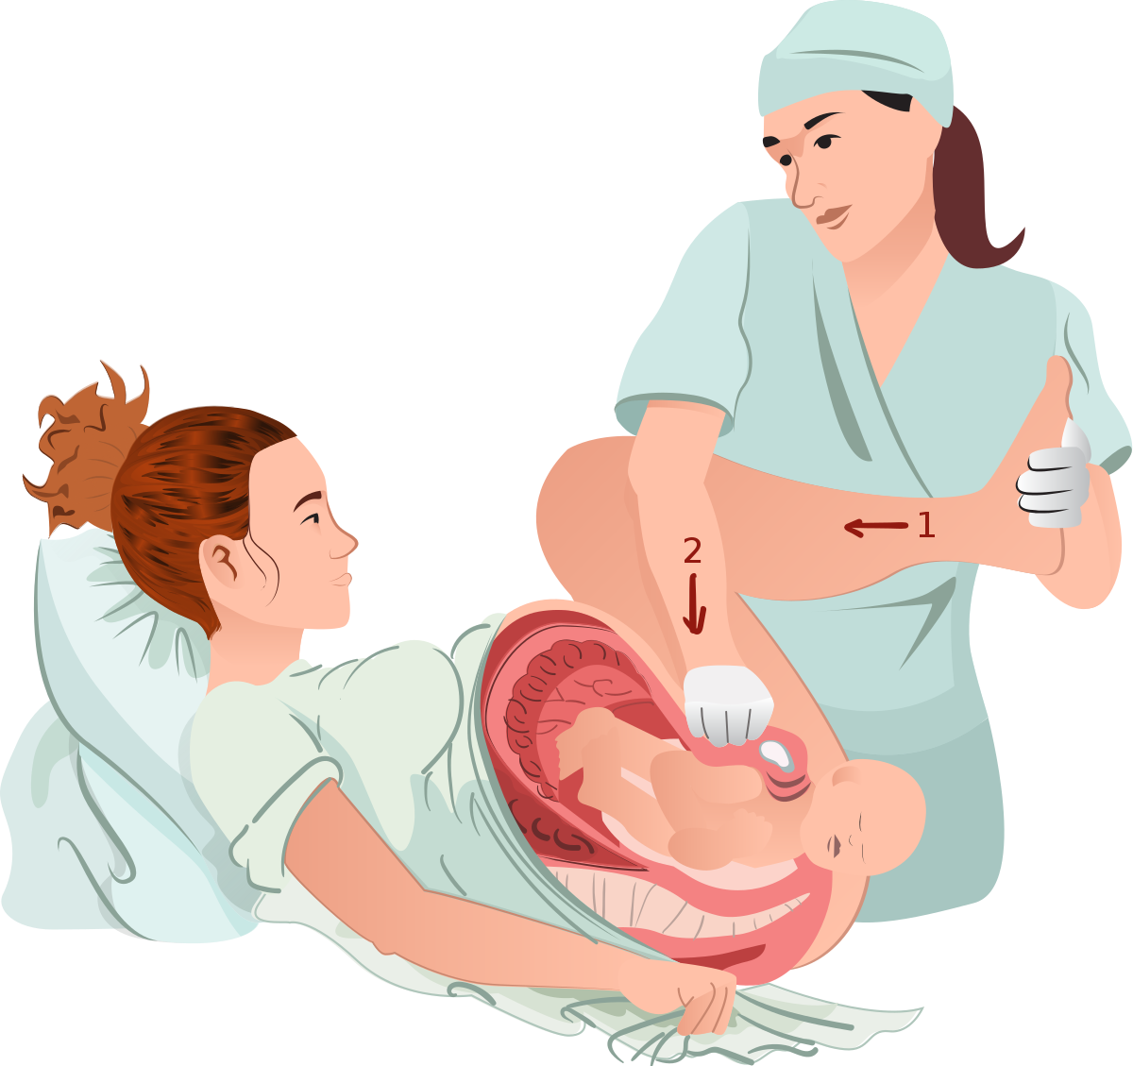
Management
McRobert’s Maneuver ± Suprapubic pressure
Two assistants grasp legs and flex backwards causing cephalad rotation of symphysis pubis and flattening of lordosis, freeing shoulder

Slide 31
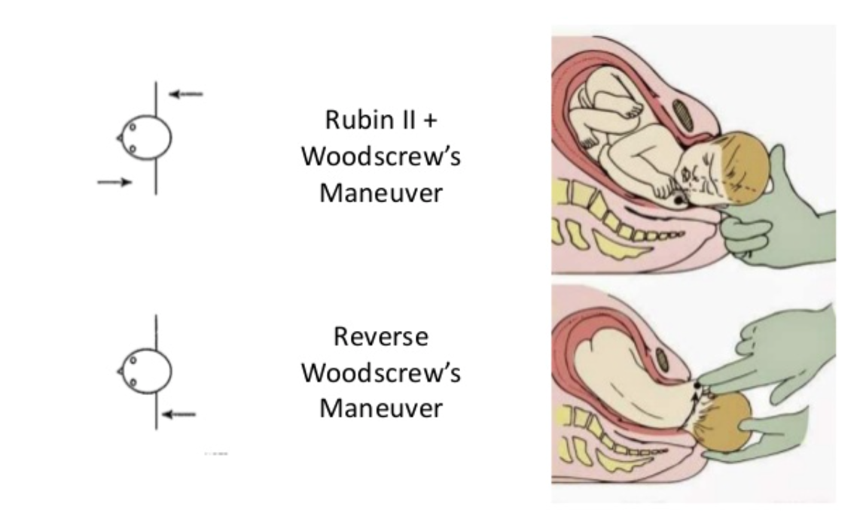
Other Maneuvers
No evidence exists for superiority of other maneuvers
Rubin maneuver, Woods Screw maneuver, Gaskin all-fours

Slide 32
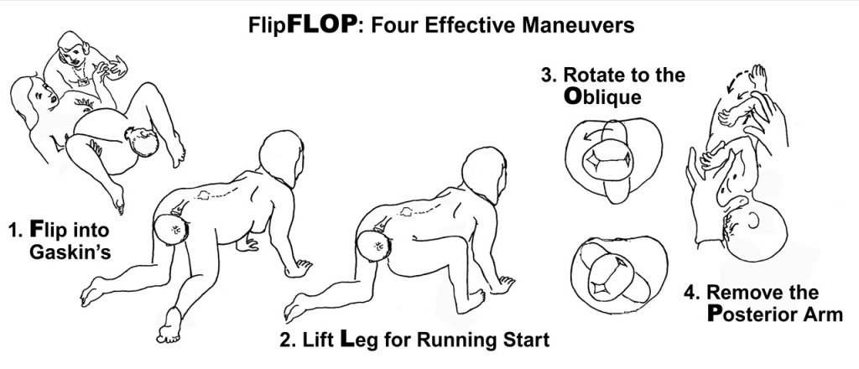
Gaskin All-Fours

Slide 33
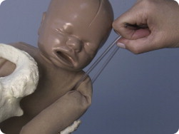
Posterior axilla sling traction (PAST)
High rates of brachial plexus insult

Slide 34
Gunn-Zavanelli-O’Leary: Last resort
Give terbutaline or nitroglycerine
Place fetal scalp electrode
Rotate head back to occiput anterior and push back into uterus as far as possible
Deliver via stat C-section

Slide 35
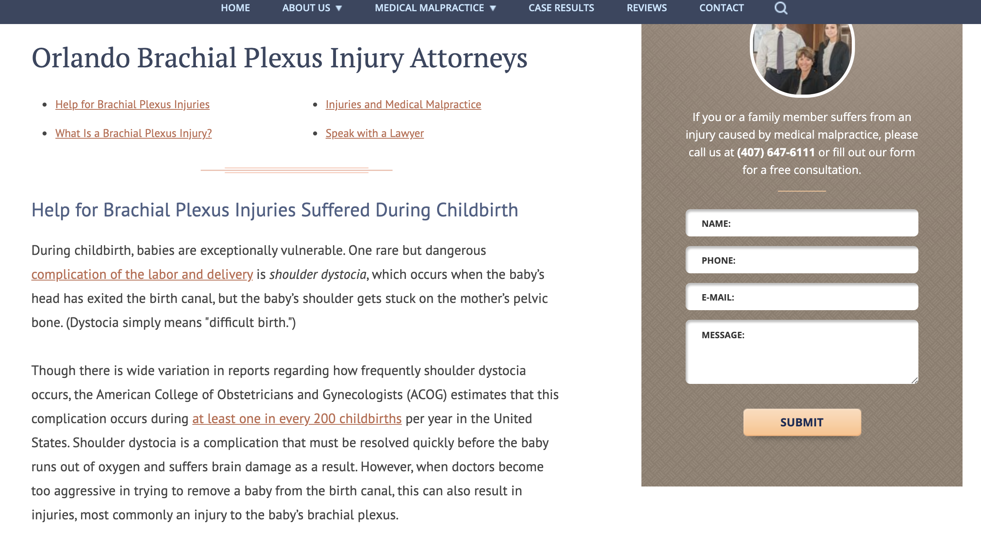
Medicolegal

Slide 36
Thank you!
Questions?

